Slide 1

Data Mining CSE347/447
Lecture 05: Dimensionality Reduction
Yu Yang

Slide 2
Agenda
Review
Dimensionality Reduction
Lehigh CSE347/447: Data Mining

Slide 3
Review
Data Transformation: Normalization
Z-score, decimal scaling, interval scaled, ratio-scaled
Data Reduction
Dimensionality reduction
Aggregation and clustering
Sampling
Data Discretization
Binning methods
Entroy-based method
Lehigh CSE347/447: Data Mining

Slide 4
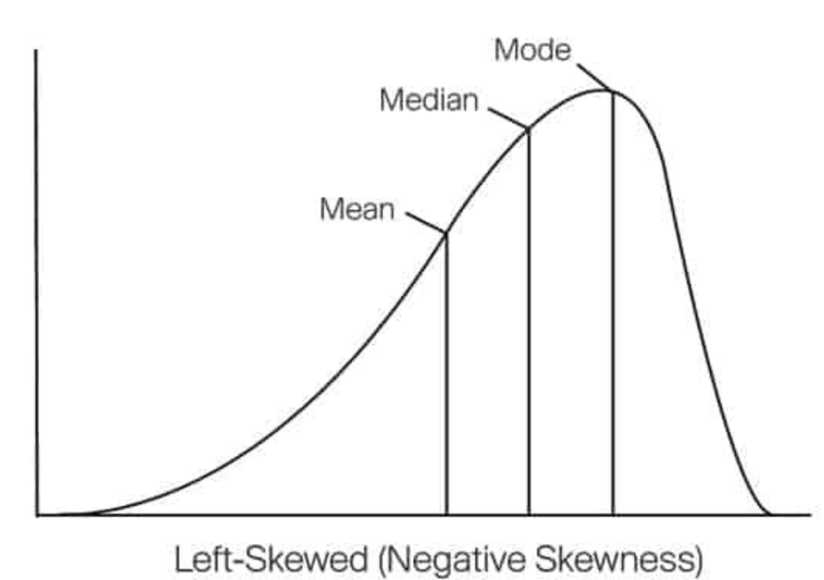
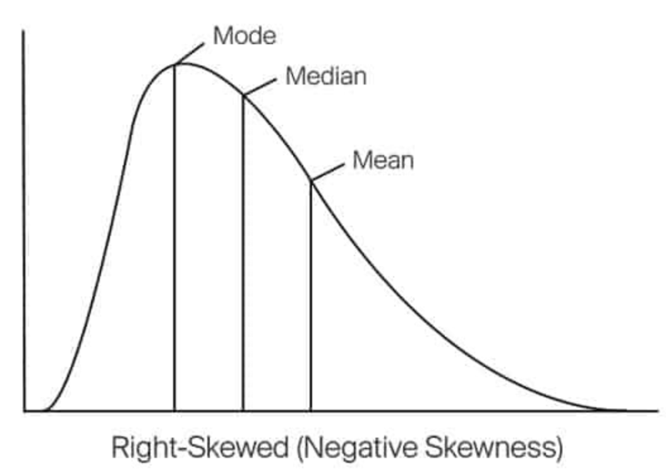
Sampling
Choose a representative subset of the data
Simple random sampling may have poor performance in the presence of skew.
Develop adaptive sampling methods
Stratified sampling:
Approximate the percentage of each class (or subpopulation of interest) in the overall database
Used in conjunction with skewed data
Lehigh CSE347/447: Data Mining

Slide 5
Dimensionality Reduction

Slide 6
What is Dimensionality Reduction?
Dimensionality reduction is the process of creating a data set with the same number of observations but less variables.
Lehigh CSE347/447: Data Mining

Slide 7
Role of Dimensionality Reduction
The knowledge discovery process
Lehigh CSE347/447: Data Mining

Slide 8
Why Dimensionality Reduction?
Curse of Dimensionality
As the dimensionality increases, the volume of the space increases so fast that the available data become sparse.
Infinite Features Requires Infinite Training!
Lehigh CSE347/447: Data Mining

Slide 9
Why Dimensionality Reduction?
Data compression
Data Complexity reduces from O(nm) to O(k(n+m))
Lehigh CSE347/447: Data Mining

Slide 10
Why Dimensionality Reduction?
Curse of Dimensionality
Data compression
Variable selection
Denoising
Visualization
Lehigh CSE347/447: Data Mining

Slide 11
Major Techniques
Feature extraction (or transformation): we create new features based on transformations or combination of the original feature set.
Feature selection: we try to find the best subset of the input feature set.
No clear-cut evidence that one of them is superior to the other on all types of tasks.
Lehigh CSE347/447: Data Mining

Slide 12
Feature Extraction V.S. Feature Selection
Lehigh CSE347/447: Data Mining

Slide 13
Feature Extraction / Transformation

Slide 14
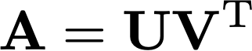
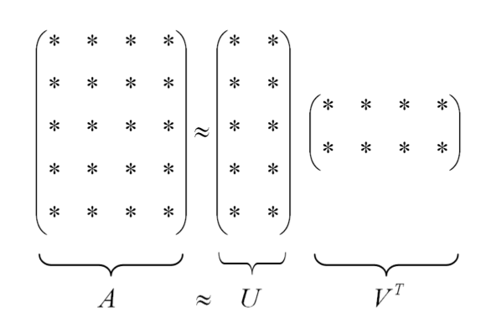
Matrix Factorization
General Form
Lehigh CSE347/447: Data Mining

Slide 15
Matrix Factorization
General Form
Lehigh CSE347/447: Data Mining

Slide 16
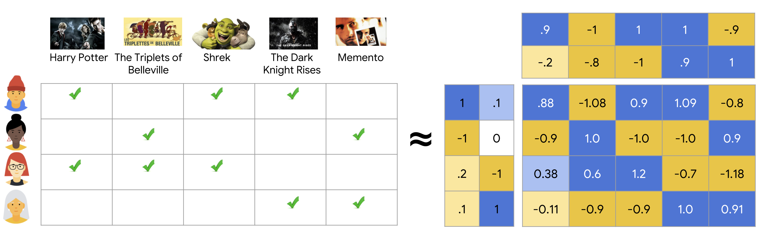
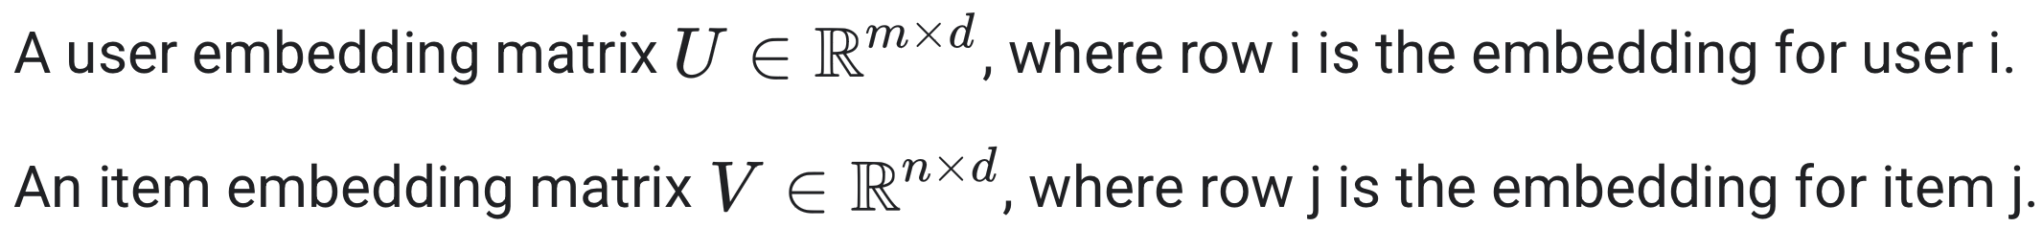
Matrix Factorization Usage
Lehigh CSE347/447: Data Mining

Slide 17
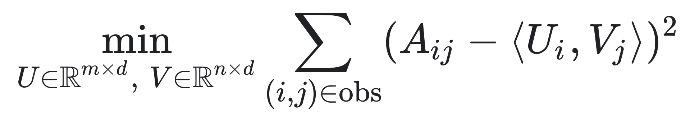
Matrix Factorization
Objective Function
Lehigh CSE347/447: Data Mining
Use numerical algorithms like the Jacobi method or power iteration.

Slide 18
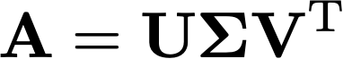
Singular Value Decomposition (SVD)
Lehigh CSE347/447: Data Mining
Notes:
U sigma, v transpose
Orthogonal matrix: QTQ = I (identity matrix)

Slide 19
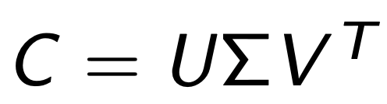
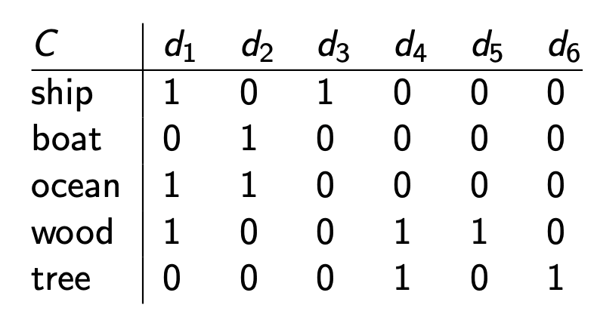
Singular Value Decomposition (SVD)
A
B
C
D
E
People (A, B, C, D, E)
Products (d1, d2, d3, d4, d5)
Lehigh CSE347/447: Data Mining
Notes:
Rotate stretch rotate
Singular values
U sigma, v transpose

Slide 20
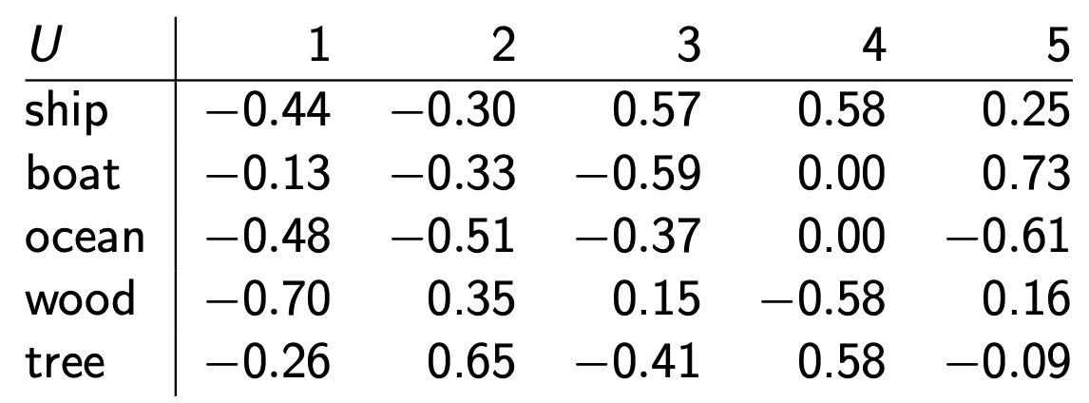
Singular Value Decomposition (SVD)
A
B
C
D
E
This is an orthonormal matrix: (i) Row vectors have unit length. (ii) Any two distinct row vectors are orthogonal to each other.
Each number u_{ij} in the matrix indicates how strongly related person
i is to the semantic dimension j.
Lehigh CSE347/447: Data Mining
Notes:
Rotate stretch rotate
Singular values
U sigma, v transpose

Slide 21
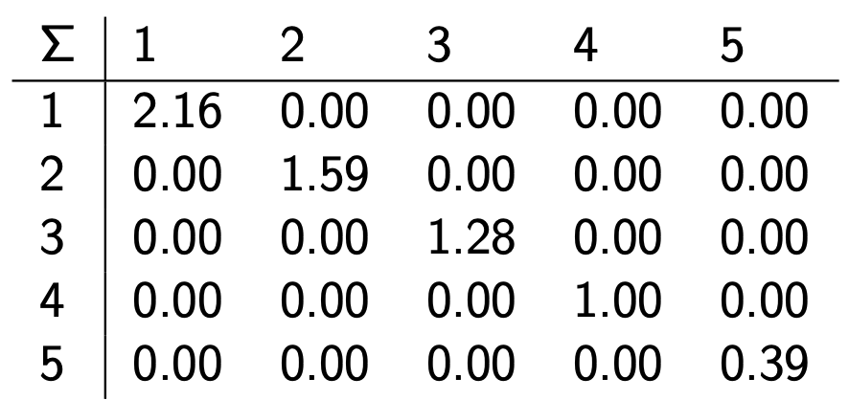
Singular Value Decomposition (SVD)
A
B
C
D
E
The diagonal consists of the singular values of C.
The magnitude of the singular value measures the importance of
the corresponding dimension.
We’ll make use of this by omitting unimportant dimensions.
Lehigh CSE347/447: Data Mining
Notes:
Rotate stretch rotate
Singular values
U sigma, v transpose

Slide 22
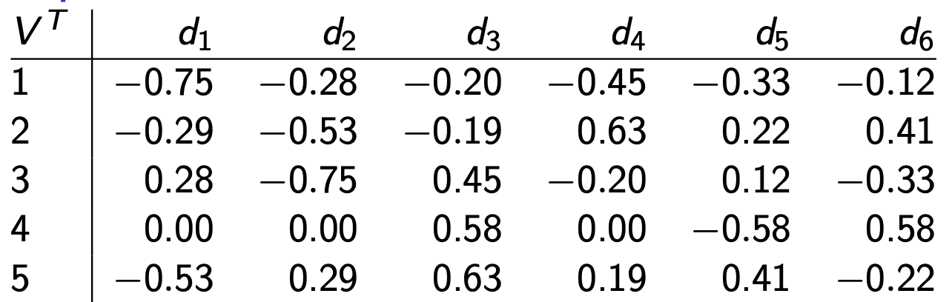
Singular Value Decomposition (SVD)
Again: This is an orthonormal matrix: (i) Column vectors have unit length. (ii) Any two distinct column vectors are orthogonal to each other.
Each number v_{ij} in the matrix indicates how strongly related product i is to the semantic dimension j.
Lehigh CSE347/447: Data Mining
Notes:
Rotate stretch rotate
Singular values
U sigma, v transpose

Slide 23
Singular Value Decomposition (SVD)
A
B
C
D
E
A
B
C
D
E
SVD is decomposition of C into
a representation of the people,
a representation of the products and
a representation of the importance of the “semantic” dimensions.
Lehigh CSE347/447: Data Mining
Notes:
Rotate stretch rotate
Singular values

Slide 24
Property of SVD that we exploit here
Key property:
Each singular value tells us how important its dimension is.
By setting less important dimensions to zero, we keep the important information, but get rid of the “details”.
These details may
be noise – in that case, reduced SVD vectors are a better representation because they are less noisy.
make things dissimilar that should be similar – again, reduced SVD vectors are a better representation because they represent similarity better.
Analogy for “fewer details is better”
Image of a blue flower
Image of a yellow flower
Omitting color makes is easier to see the similarity
Lehigh CSE347/447: Data Mining
Notes:
Rotate stretch rotate
Singular values
U sigma, v transpose

Slide 25
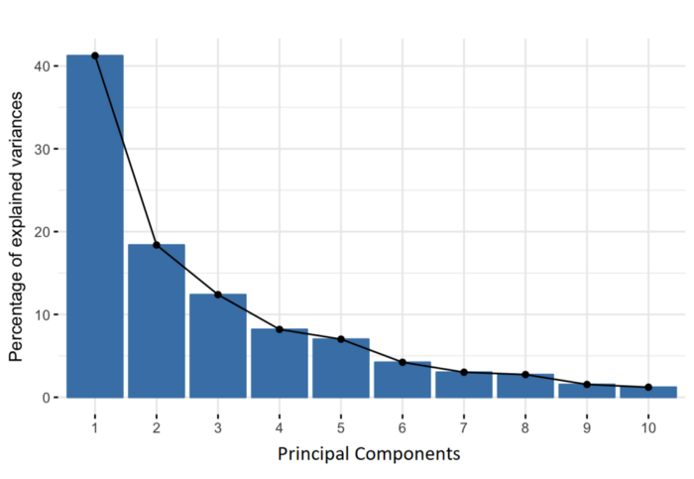
Principal Component Analysis (PCA)
Principal components are new variables that are constructed as linear combinations or mixtures of the initial variables.
Most of the information within the initial variables is squeezed or compressed into the first components
How many possible components?
N-dimensional data
Maximal amount of variance
Lehigh CSE347/447: Data Mining
Notes:
An important thing to realize here is that the principal components are less interpretable and don’t have any real meaning since they are constructed as linear combinations of the initial variables.
Geometrically speaking, principal components represent the directions of the data that explain a maximal amount of variance, that is to say, the lines that capture most information of the data. The relationship between variance and information here, is that, the larger the variance carried by a line, the larger the dispersion of the data points along it, and the larger the dispersion along a line, the more information it has. To put all this simply, just think of principal components as new axes that provide the best angle to see and evaluate the data, so that the differences between the observations are better visible.

Slide 26

Principal Component Analysis (PCA)
How projections look like for different lines
Lehigh CSE347/447: Data Mining
Notes:
the line that matches the purple marks because it goes through the origin and it’s the line in which the projection of the points (red dots) is the most spread out.

Slide 27
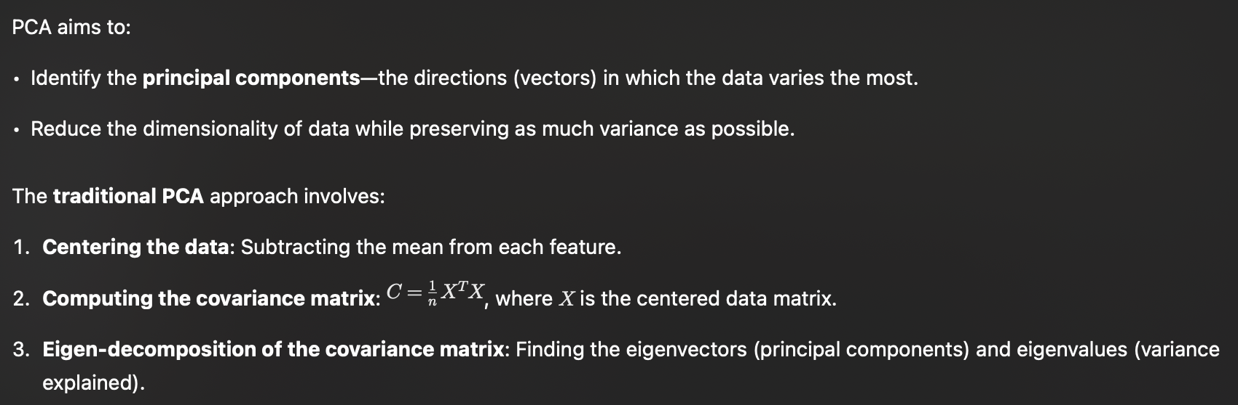
Principal Component Analysis (PCA)
PCA finds the “best” line to maximize variance in principal component space (i.e., minimize least-squares reconstruction error).
Lehigh CSE347/447: Data Mining

Slide 28
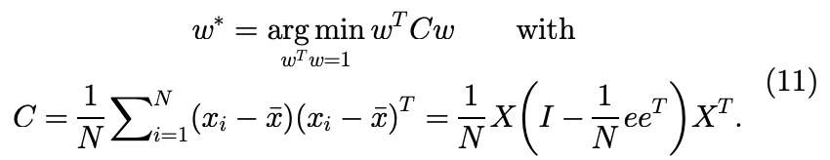
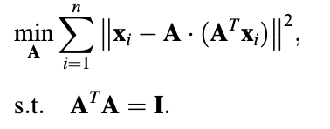
Principal Component Analysis (PCA)
General Formula
PCA
or
Lehigh CSE347/447: Data Mining

Slide 29
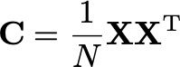
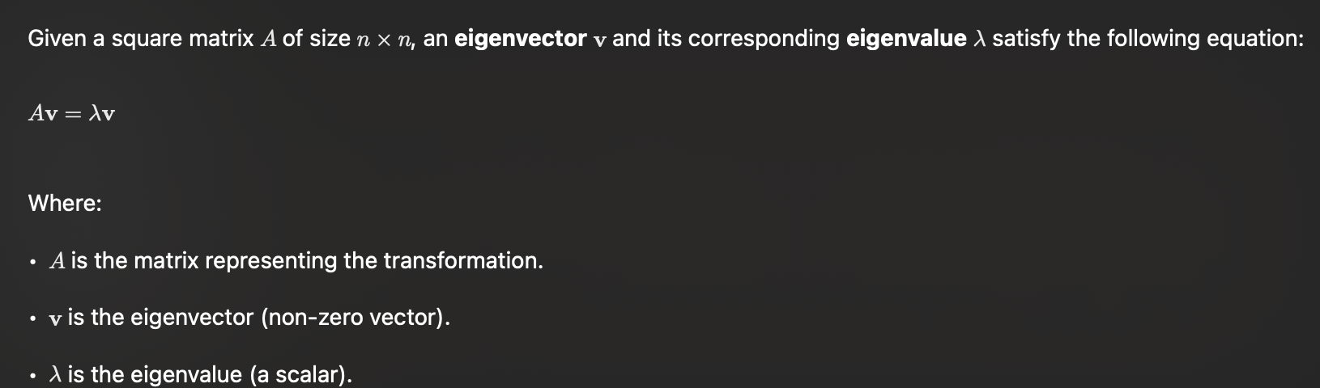
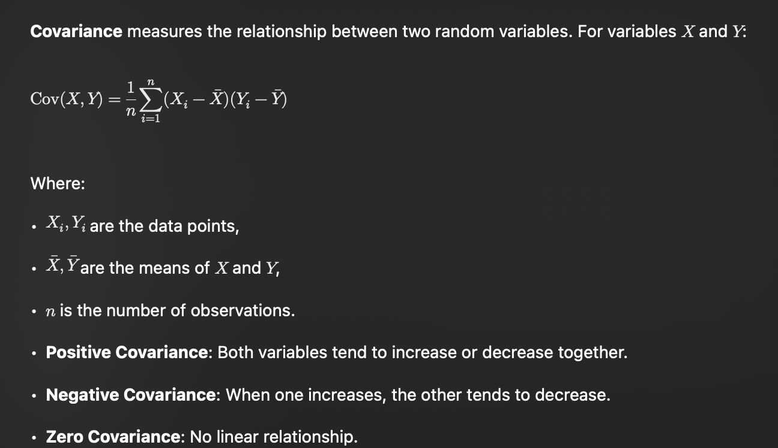
Principal Component Analysis (PCA)
Steps Involved:
MUST perform standardization on data(X), i.e., subtract the mean from data.
Construct the covariance matrix of the data.
Compute the eigenvectors of this matrix C.
Eigenvectors corresponding to the largest eigenvalues are used to reconstruct a large fraction of variance of the original data.
Lehigh CSE347/447: Data Mining
Notes:
An eigenvector is a special type of vector associated with a square matrix that remains in the same direction after a linear transformation, though its magnitude may change. The amount by which its magnitude changes is called the eigenvalue.

Slide 30
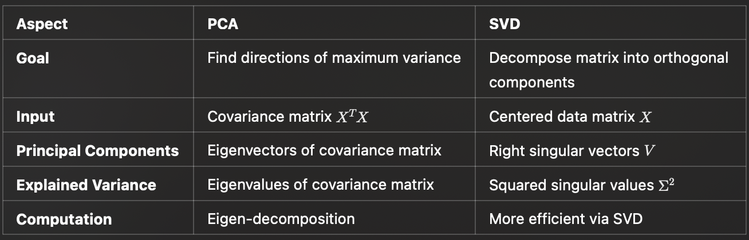
Principal Component Analysis (PCA)
See In Depth: Principal Component Analysis
Lehigh CSE347/447: Data Mining

Slide 31
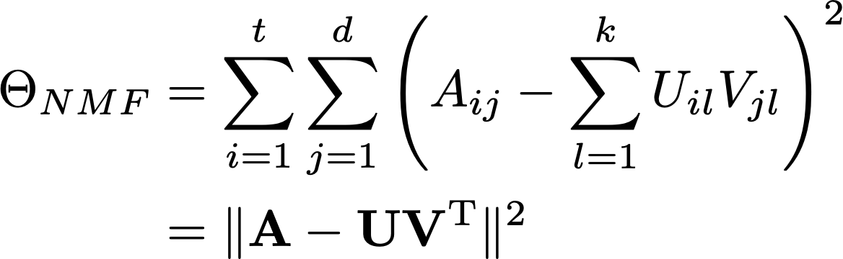
Non-negative Matrix Factorization (NMF)
Process a nonnegative input matrix.
Non-negative base vectors: U>0 & V>0.
Lehigh CSE347/447: Data Mining

Slide 32
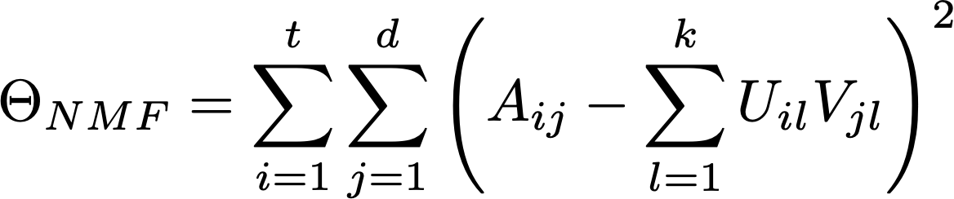
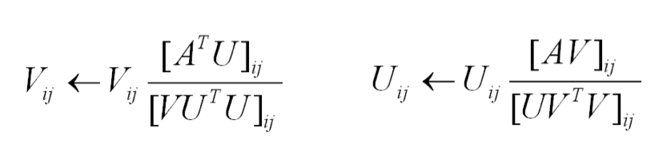
Non-negative Matrix Factorization (NMF)
How to decompose?
Multiplication Update Algorithm
Lehigh CSE347/447: Data Mining

Slide 33
Feature Extraction
Linear
Singular Vector Decomposition (SVD)
Principal Component Analysis (PCA)
Non-negative Matrix Factorization (NMF)
Non-linear Dimensionality Reduction?
Lehigh CSE347/447: Data Mining

Slide 34
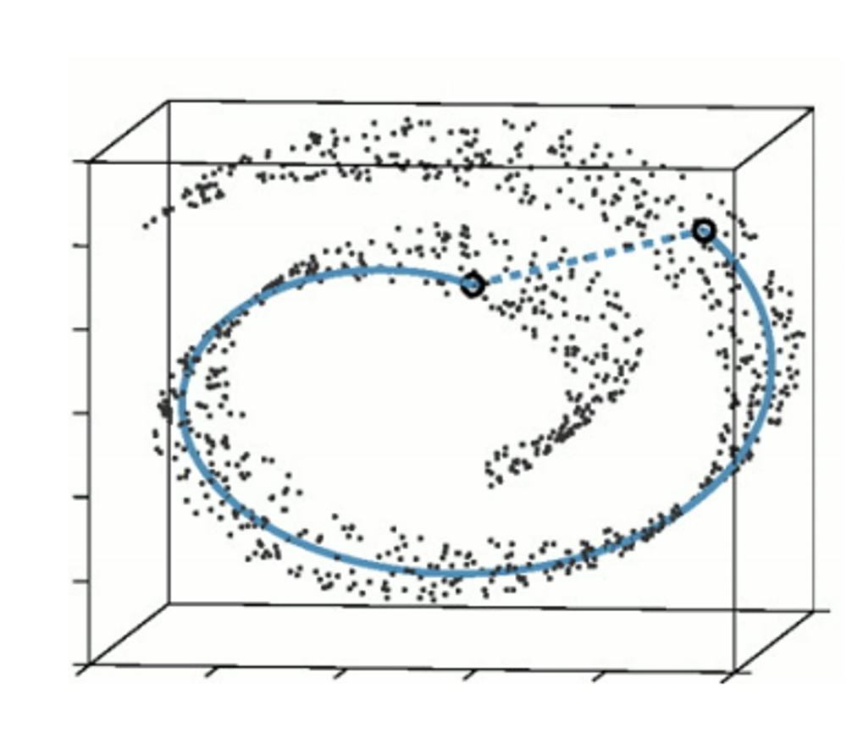
Non-linear Dimensionality Reduction
A special class of problem
Low dimensional data lying on a manifold in a higher dimensional space
Lehigh CSE347/447: Data Mining

Slide 35
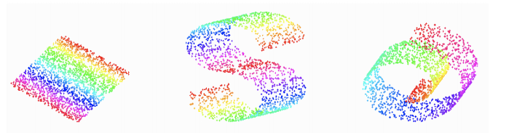
Manifold Learning
Three examples of manifolds
All three are two-dimensional manifolds embedded in 3 dimensions
Linear, “S”-shape, “Swiss roll”
For all three, we would like to recover:
That the data is only two-dimensional
“Consistent” locations for the data in 2D
What are “consistent” locations
Preserve local relationship and structure
E.g., data points that are close together in high-dimensional space should remain close in the lower-dimensional embedding.
Lehigh CSE347/447: Data Mining
Notes:
data points that are close together in high-dimensional space should remain close in the lower-dimensional embedding.

Slide 36
Laplacian Eigenmaps
Hypothesis: Real-world high-dimensional data often lies on or near a lower-dimensional manifold
Capture the local geometry of the data by constructing a graph of the data points.
Preserve local neighborhood information during dimensionality reduction.
Lehigh CSE347/447: Data Mining
Notes:
data points that are close together in high-dimensional space should remain close in the lower-dimensional embedding.

Slide 37
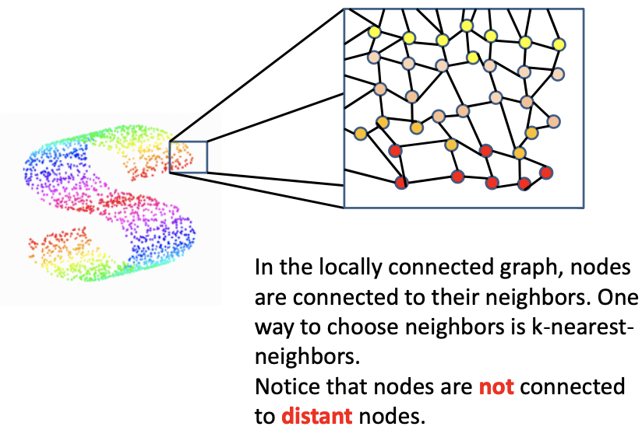
Laplacian Eigenmaps
Local Neighborhood Graph
Lehigh CSE347/447: Data Mining
Notes:
data points that are close together in high-dimensional space should remain close in the lower-dimensional embedding.

Slide 38
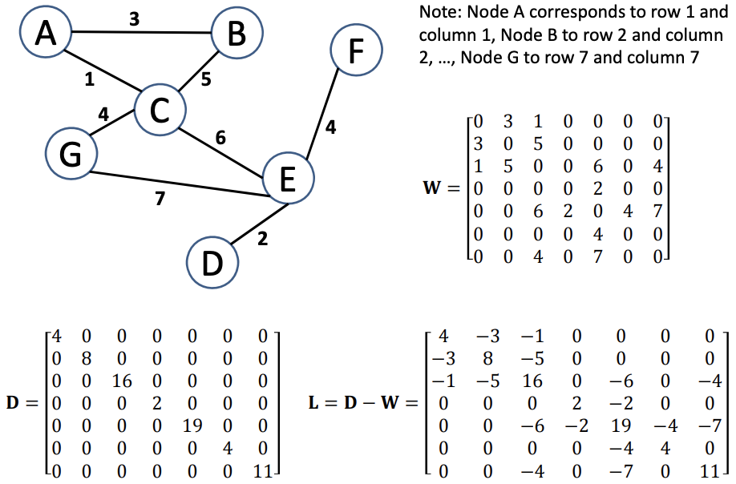
Laplacian Eigenmaps
Laplacian Matrix of a Graph
Lehigh CSE347/447: Data Mining
Notes:
data points that are close together in high-dimensional space should remain close in the lower-dimensional embedding.

Slide 39
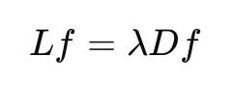
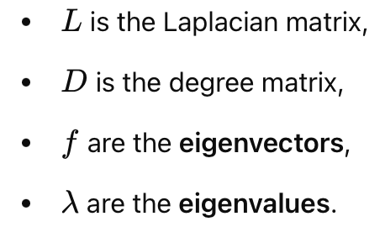
Laplacian Eigenmaps
L: Laplacian Matrix of a Graph
Solve the generalized Eigenvalue Problem
Lehigh CSE347/447: Data Mining
Notes:
W: Similarity (Weight) Matrix
D: degree matrix
Discard the first eigenvector (corresponding to the zero eigenvalue, which represents the trivial solution).The next k smallest non-zero eigenvectors form the low-dimensional embedding.

Slide 40
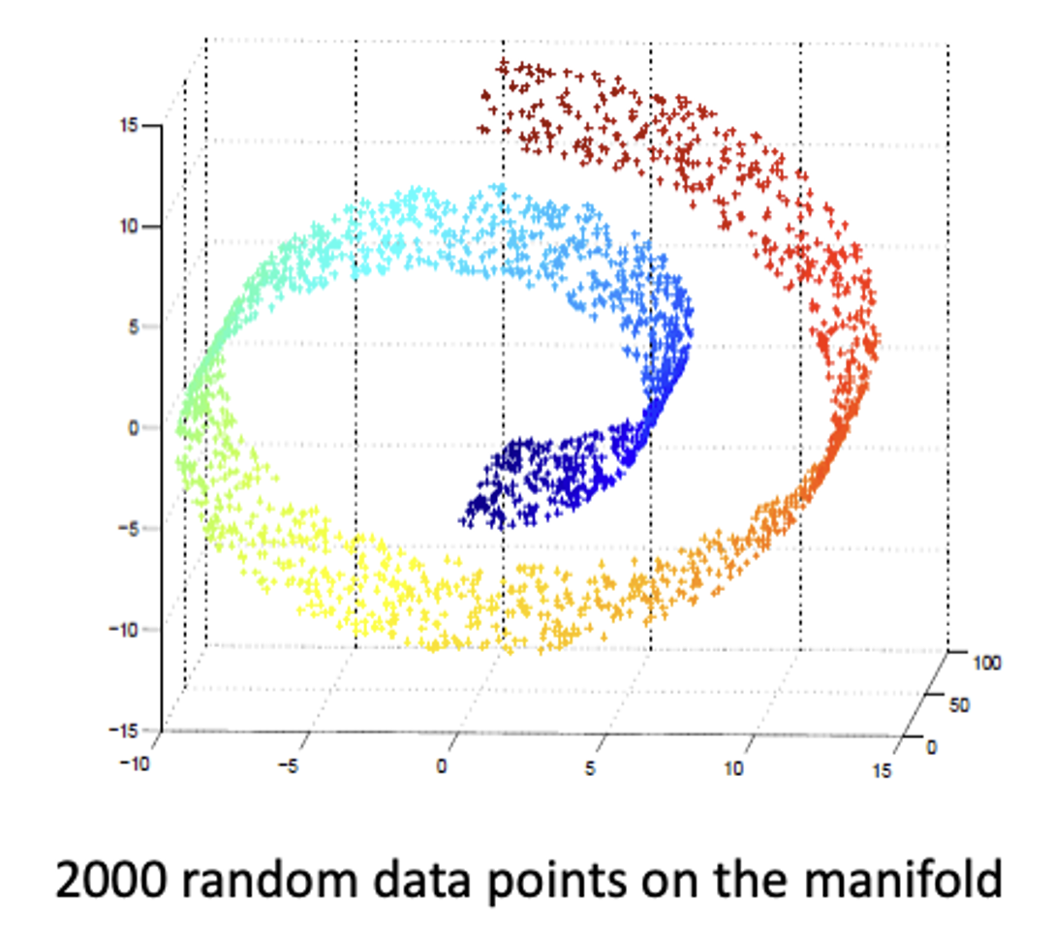
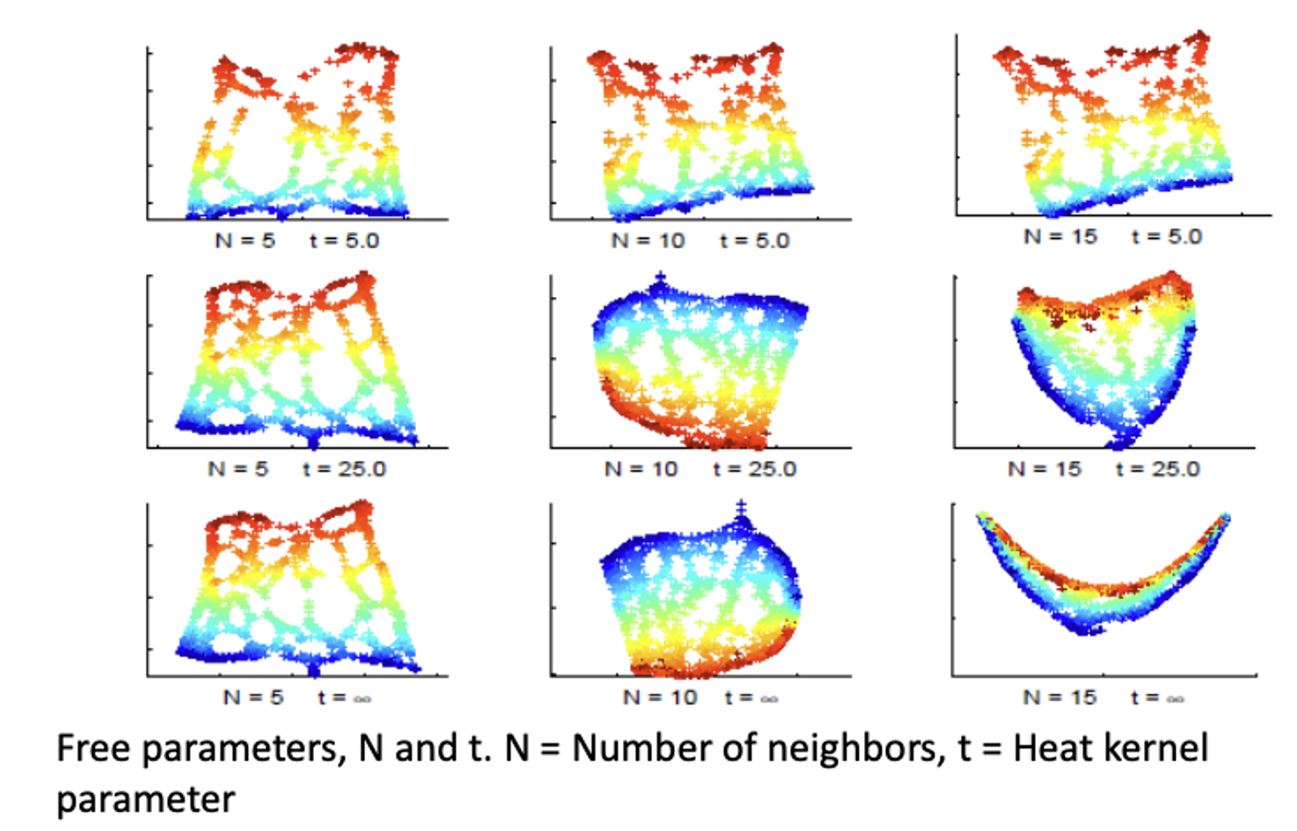
Laplacian Eigenmaps
Lehigh CSE347/447: Data Mining
Notes:
data points that are close together in high-dimensional space should remain close in the lower-dimensional embedding.

Slide 41

Next Lecture: Feature Selection & Similarity Measure
Feedback and Suggestions
https://forms.gle/zsA7ZW76nbd7qPvTA
Anonymous and Live until the end of the semester
(verified with your Lehigh email)

